Slide 1
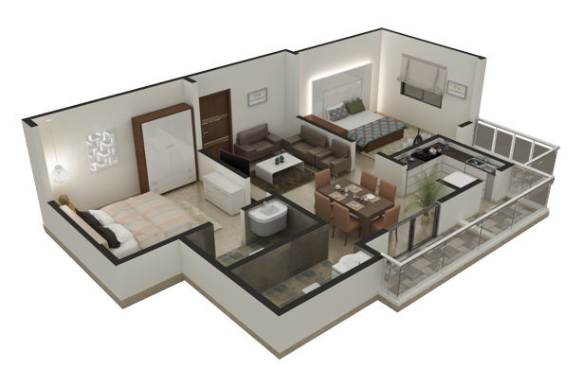
Modelling of Domestic Cooling Loads and AC
Project Presentation

Slide 2
Problem Statement
Karachi
Lahore
Larkana
Islamabad
Sibi
Hyderabad
MAX T = 40°C
RH = 75%
MAX T = 43°C
RH = 30%
MAX T = 46°C
RH = 24%
MAX T = 38.0°C
RH = 40%
MAX T = 47.0°C
RH = 46%
MAX T = 40.0°C
RH = 49%

Slide 3

Solution?
What is the Solution to these Infinite Scenarios?

Slide 4
Cooling Load Model
MATLAB
Size of Room
Solar Radiation
No of Occupants
…
Calculation
Compilation
...
Total Load
Graphical Data
Numeric Data
Requirements
Results

Slide 5

How?
The Timeline and Project Progression

Slide 6
Strategy Behind Modelling
Loads
Modelling
MATLAB
Simulink
Simscape
Excel UI/UX
1
2
3
Identification of Cooling Loads
Modelling of Each Load Separately
Creating Required Variables
4
5
6
Assembling all the Models
Modelling the Thermal and Fluid Properties
User-Interface or User Control in Excel

Slide 7









Loads

Slide 8
Categorization
Category A
Category B
Sensible Loads (Direct)
Latent Loads (Moisture)

Slide 9
Continued...
A (I)
A (II)
A (IV)
A (V)
A (VI)
A (VIII)
B (I)
B (II)
Walls and Windows
Solar
Lights
Occupants Sensible
Infiltration Sensible
Fans
Infiltration Latent
Occupants Latent

Slide 10


Modelling in MATLAB
A(I)
A(VIII)
Master Script
A(VI) B(I)
A(II)
A(IV)
A(V) B(II)
Master Script
Evapor
Conde
Compr
Accum
TEV
Simulink Model

Slide 11

Features
What the Model is Capable of?

Slide 12
Example Scenario
Room
13 x 16 x 10.8 ft
Conditions
Environment Temperature = 52°C
Loads
Solar, Lights, Walls, Appliances, Infiltration, Occupants
Room Temperature = 40°C
Simulation
Time = 10000s , Time-Step = 1s
AC
1.5 Tons
Occupants
Lights
4 LED , 2 Tube Lights
2

Slide 13


Slide 14
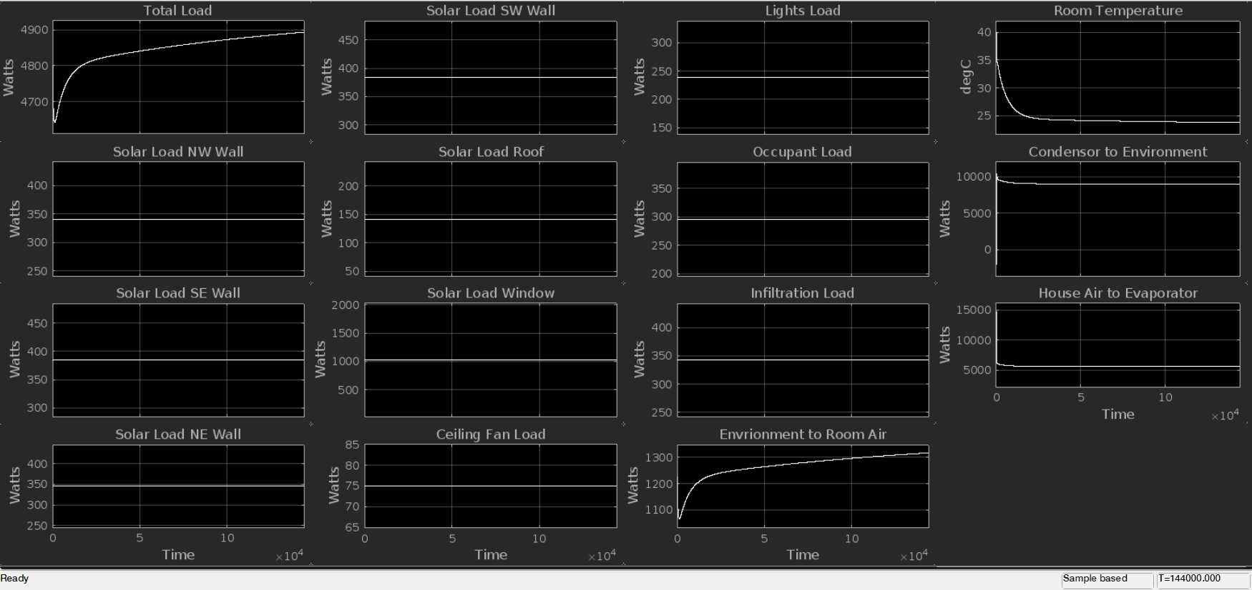
Results

Slide 15
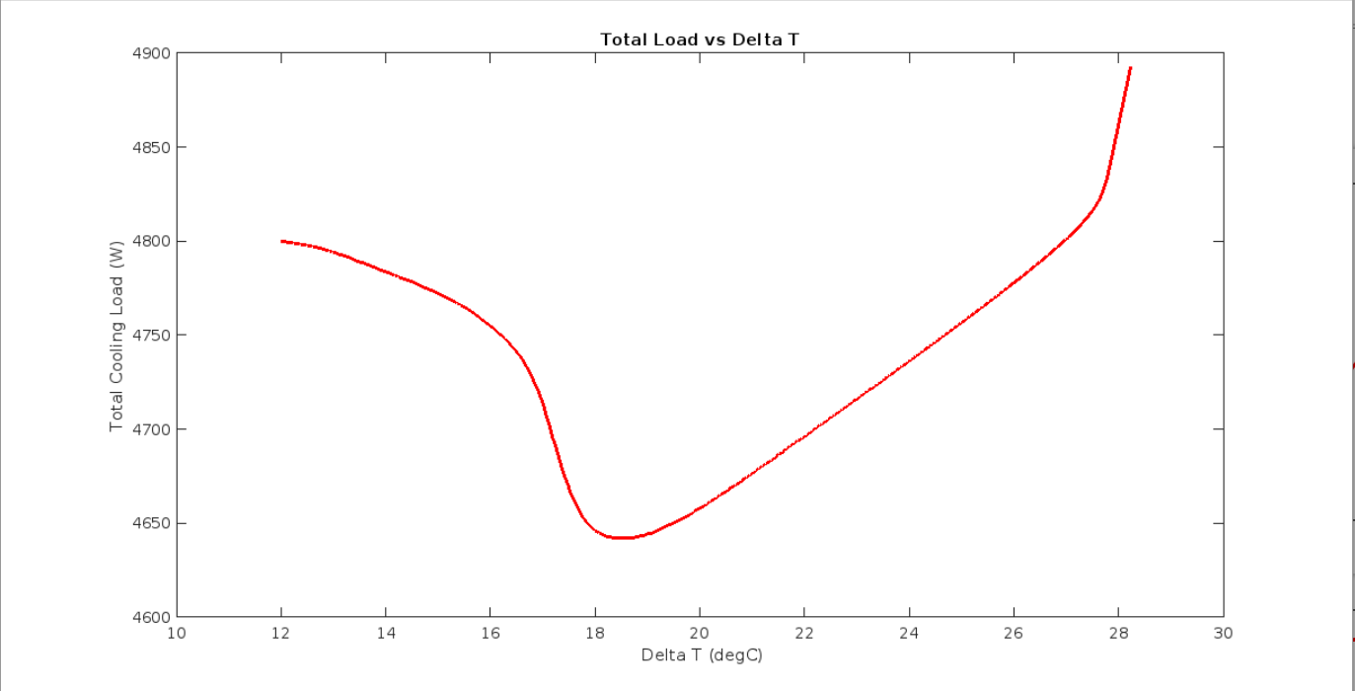
Continue..

Slide 16
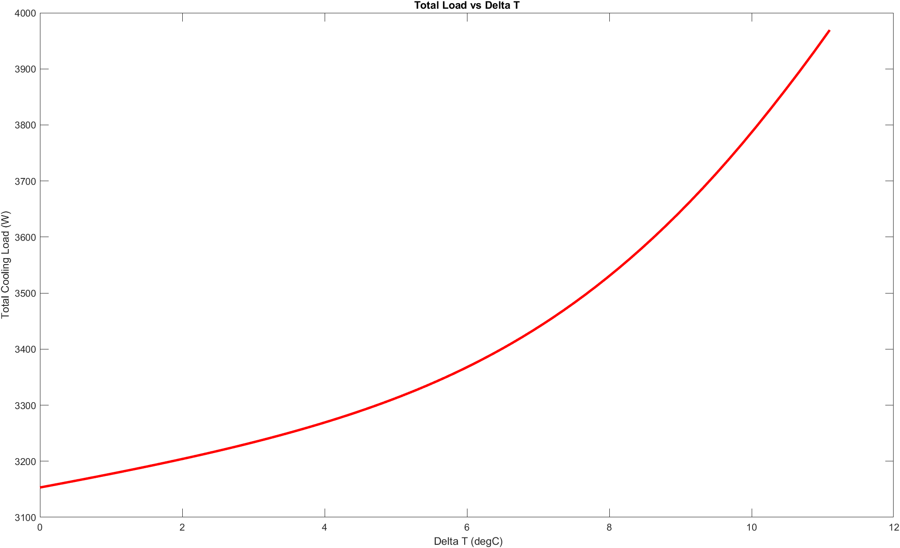
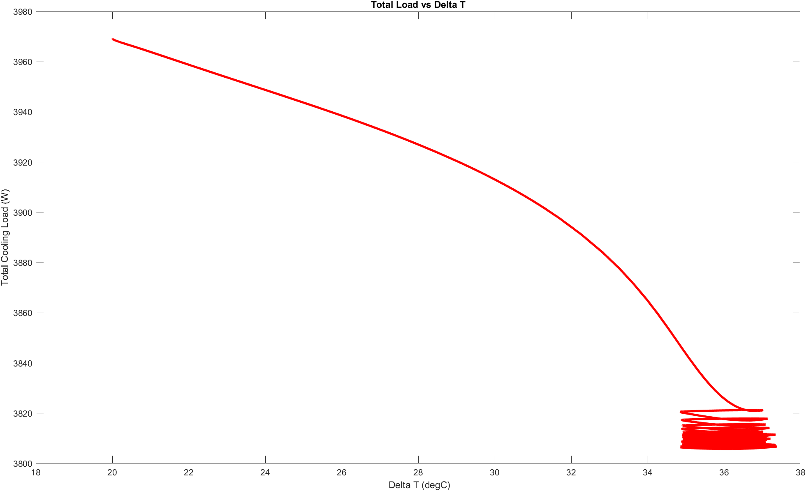
Results
Refrigeration OFF
Refrigeration ON
Environment Temperature = 52°C
Initial Room Temperature = 32°C
Target Temperature = 16°C

Slide 17

Snapshots
A little peek in into the details

Slide 18
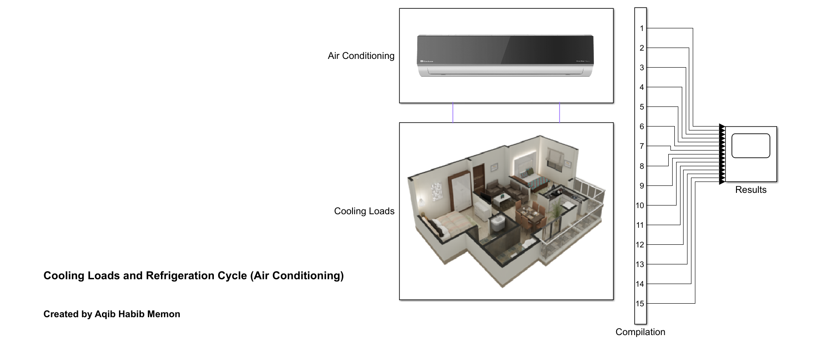
Top-Level

Slide 19
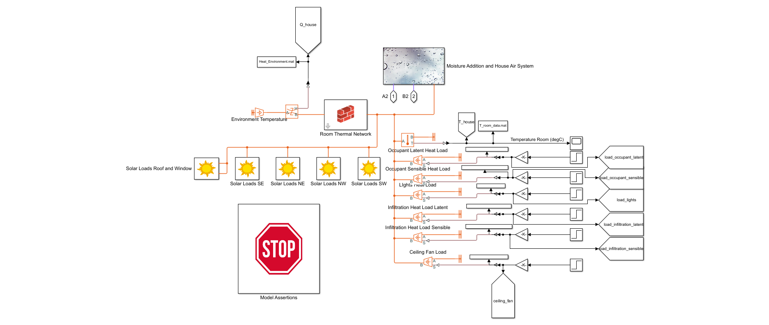
Cooling Loads

Slide 20
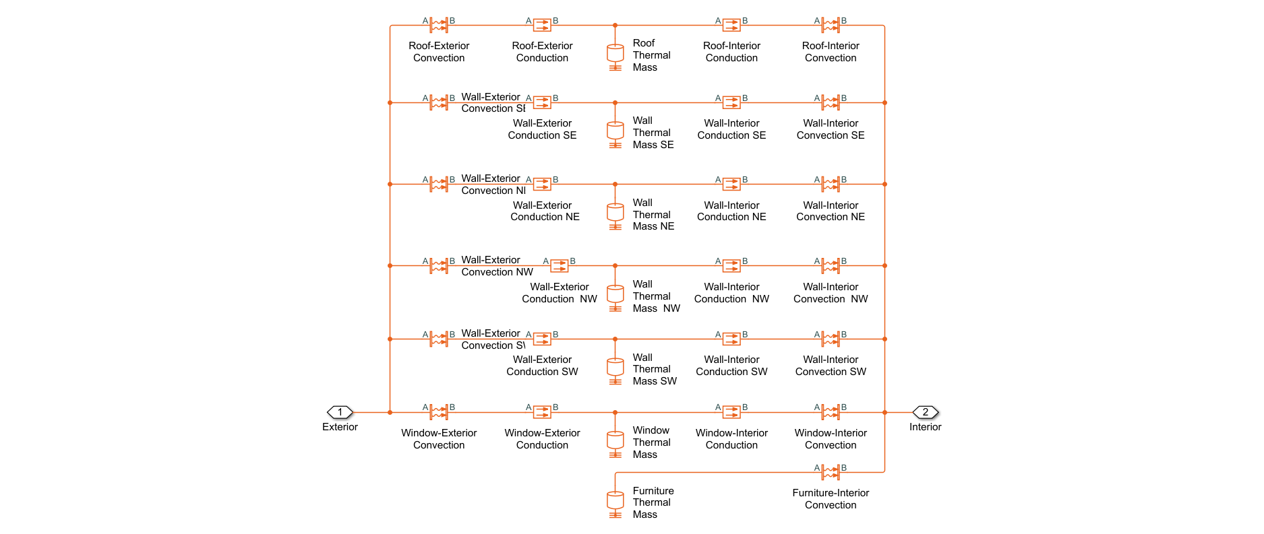
Walls and Thermal Inertia

Slide 21
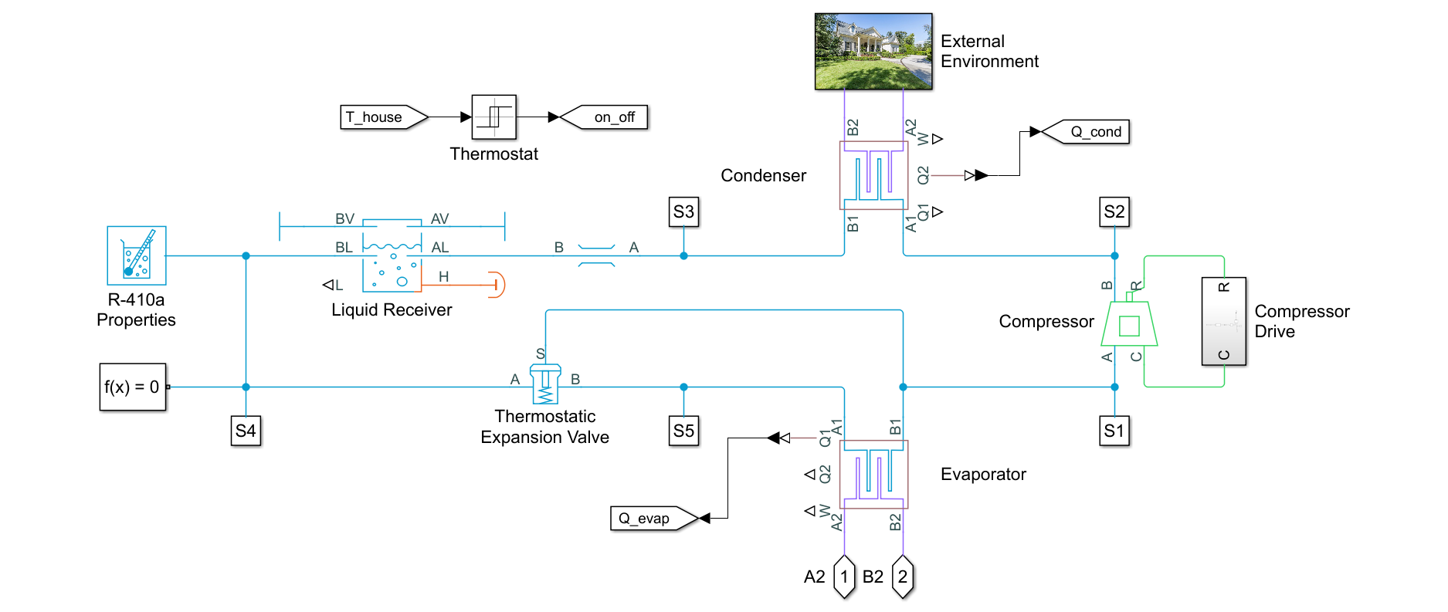
Model of AC

Slide 22
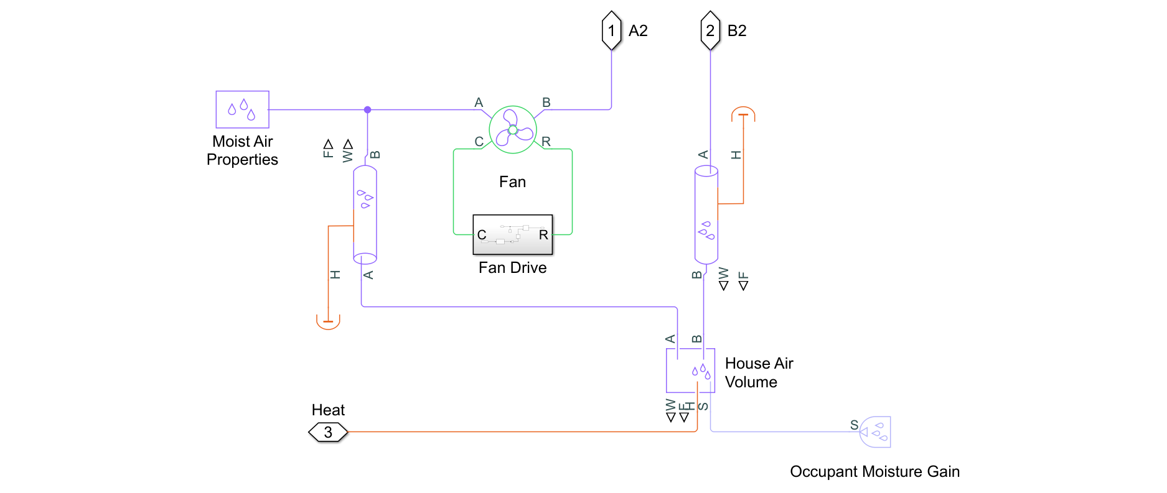
Moisture Control

Slide 23
Summary of Features
Parameters Control in Excel
Dynamic or Constant Cooling Loads
Can simulate with or without AC
Auto-Compilation of Numerical Results in Excel
Selection of Simulation Time
Custom Properties of AC Components

Slide 24
Benefits and Advantages
Behavior of Cooling Loads in different conditions
Performance of New AC Prototypes
Testing of Realistic Scenarios in AC Lab
Robust and Market Ready Product
Time Saving

Slide 25
Time Saving
Field Tests
Days
Time in MATLAB
Minutes

Slide 26
Energy Savings
Field Test
100 Units on Average Test
Cost Saved?
4015 PKR per Field Test (99%)

Slide 27
Time Saving
Time Per Lab Simulation
6 Hours
Time in MATLAB
10 Minutes (97%)

Slide 28
Future Developments
Graphical User Interface
Direct Integration with AC Lab Software
To be used in Dawlance Website
To be showcased at Dawlance Experience Centers
Machine Learning/AI

Slide 29
Machine Learning
Units Consumed
1090.1 on average per day
Cost Saved?
32,703 PKR per day
(Up to 1 Million Per Month)

Slide 30

Thanks!

